Slide 1
Database
Student Database Management system

Slide 2
2.0 Introduction
We are going to start working on a project to automate the operation of student. We are calling the system as student database management system. Currently all the operation is done manually from Guardian,Student,Class Rec,teacher and term record checking and assigning work . So we are trying to make it easier for people to entry for then people that will help them easily entry and arrange the work.

Slide 3
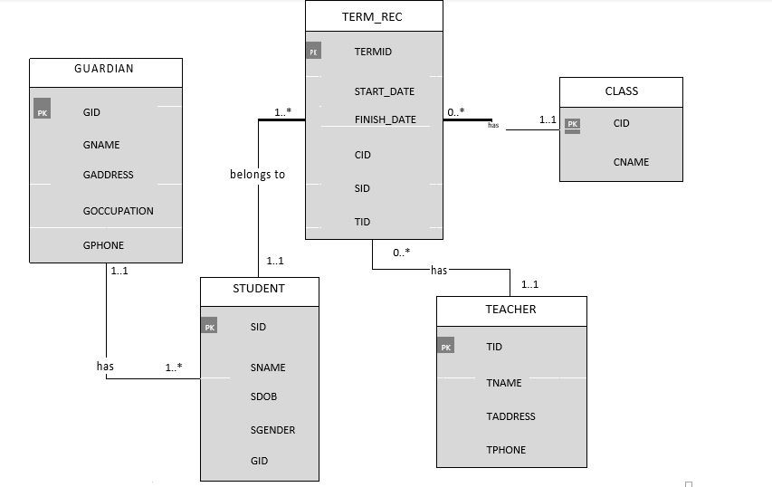
ER diagram

Slide 4
3.0 DATA DICTIONARY FOR ER DIAGRAM
Guardian
Class
Attribute Name | Data Type | Size | NULL
GID (PK) | Number | 3 | not
GADDRESS | Varchar2 | 25 | not
GOCCUPATION | Varchar2 | 15 | yes
GPHONE | Varchar 2 | 15 | not
Attribute Name | Data Type | Size | NULL
CID(PK) | Number | 3 | not
CName | Varchar2 | 15 | not
Teacher
Attribute Name | Data Type | Size | NULL
TID (PK) | Number | 3 | not
TName | Varchar2 | 20 | Not
TAddress | Varchar2 | 25
TPhone | Varchar2 | 15 | not
Student
Attribute Name | Data Type | Size | NULL
SID (PK) | Number | 3 | not
SName | Varchar2 | 25 | not
SDOB | date |  | Not
S | Char | 1 | Not
GID(FK) | Varchar 2 | 15 | not
Term_Rec
Attribute Name | Data Type | Size | NULL
Termid (PK) | Number | 3 | Not
Startdate | Date |  | Not
FinishDate | Date |  | Not
CID (FK) | Number | 3 | not
SID(FK) | Number | 5 | not
TID(FK) | Number | 5 | not

Slide 5
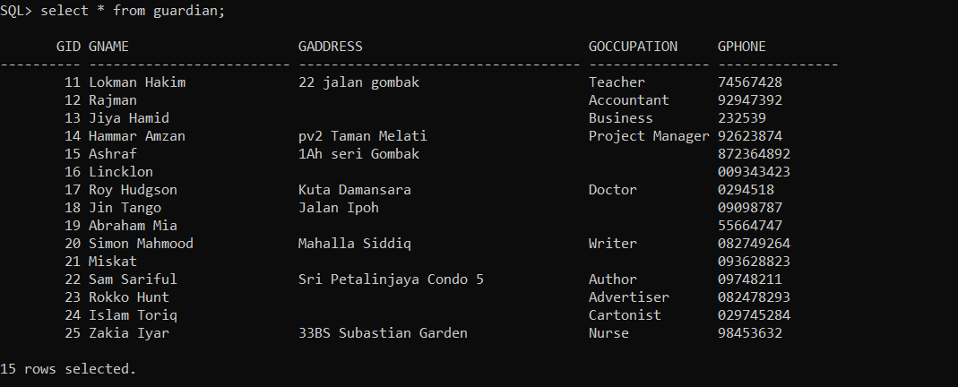
Guardian

Slide 6
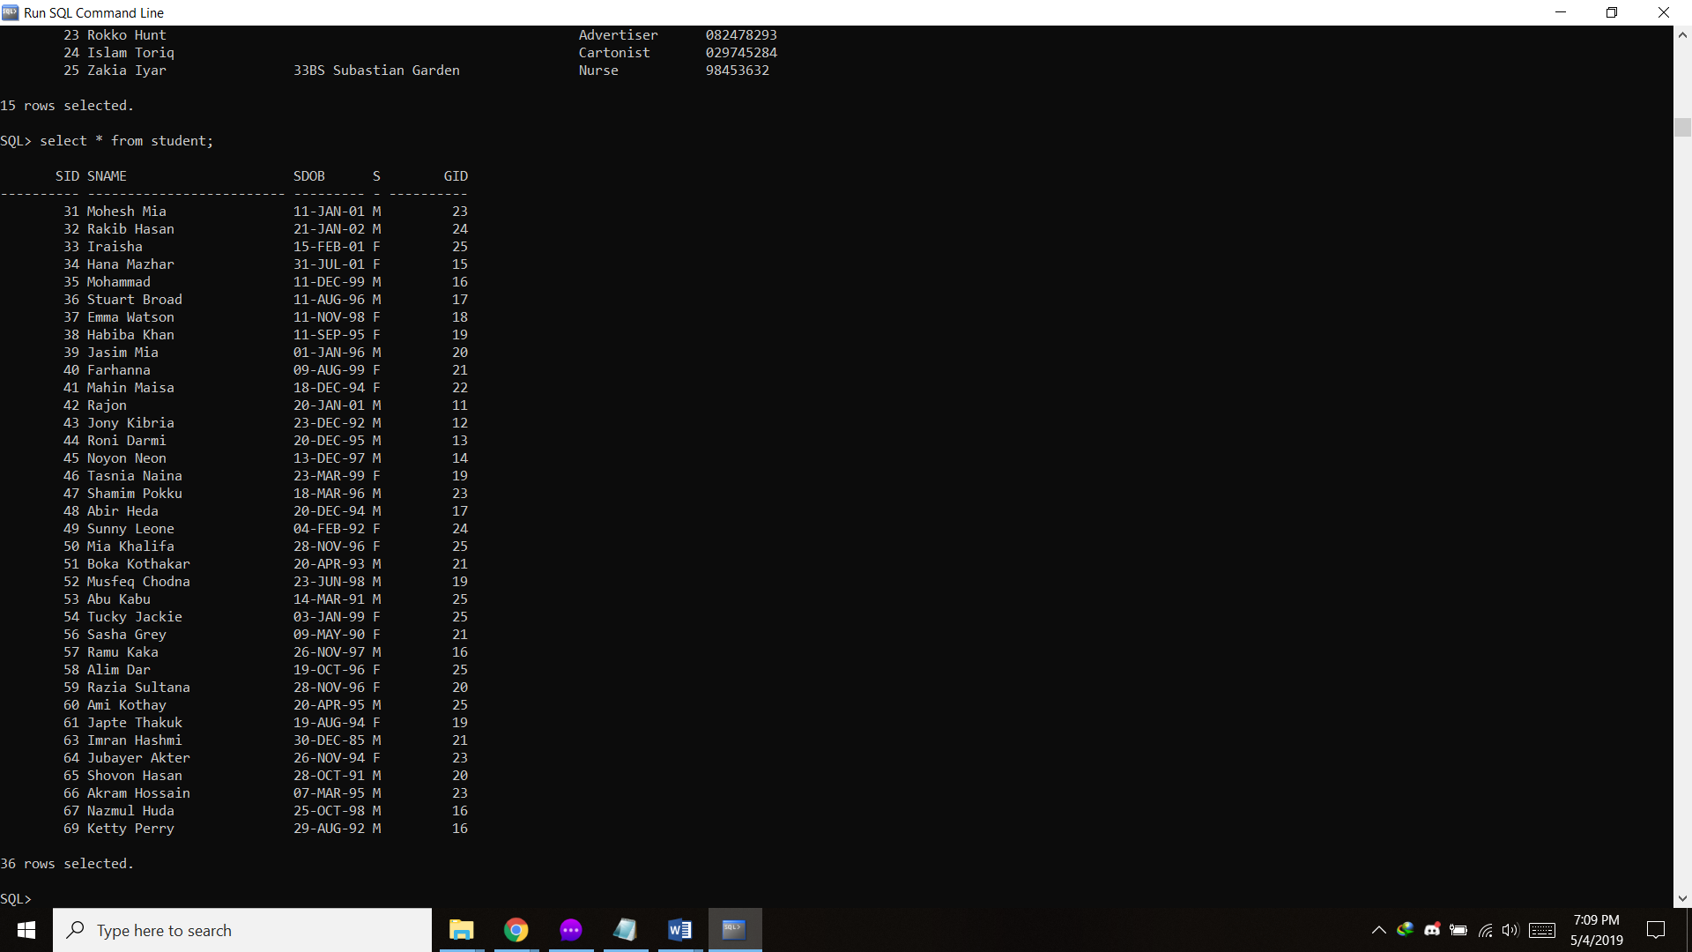
Student

Slide 7
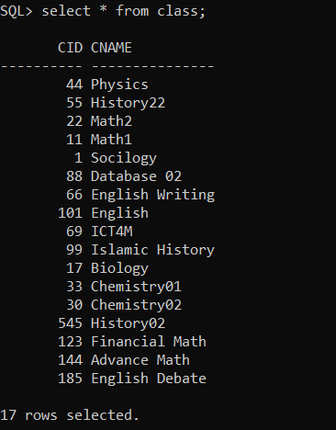
Class

Slide 8

Teacher

Slide 9
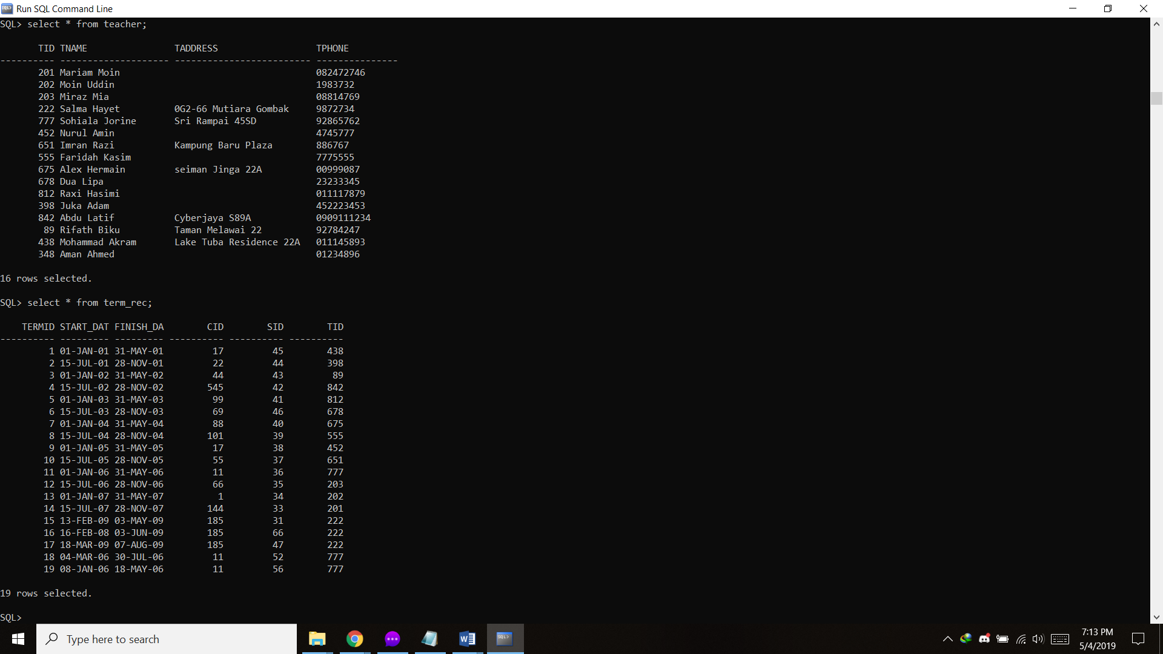
Term_Rec

Slide 10
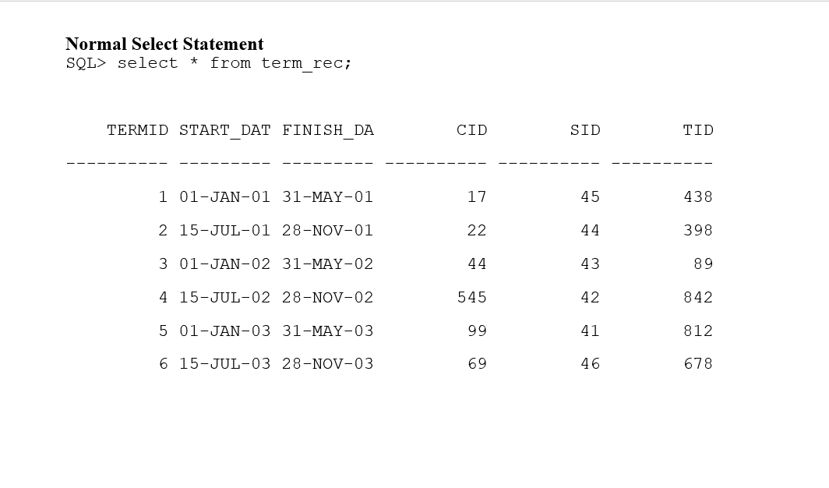
QUERY, ADD, REMOVE, INSERT & MODIFY DATA
INSERT INTO TERM_REC VALUES(1, TO_DATE('01-JAN-01') , TO_DATE('31-MAY-01'),17,45,438);

Slide 11
Select Statement to find people with student id
SQL> select sname from student where sid=31;
SNAME
-------------------------
Mohesh Mia

Slide 12

Find the class with the most students.
SELECT class.cname,COUNT(student.sid) as students
FROM TERM_REC JOIN class ON class.cid = TERM_REC.cid JOIN student ON student.sid=TERM_REC.sid
GROUP BY class.cname
ORDER BY students desc;

Slide 13
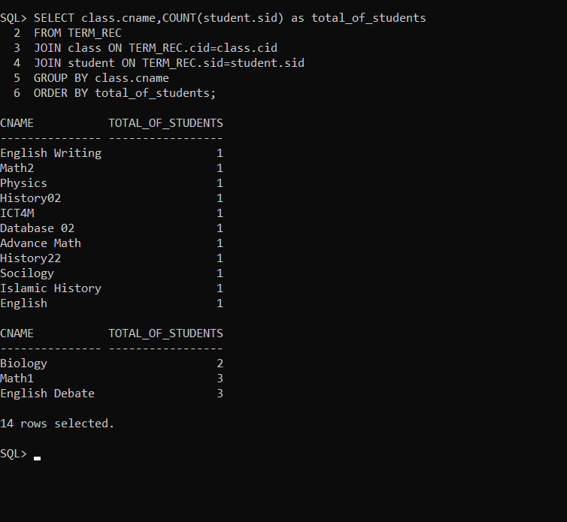
List the total number of students in every class.
SELECT class.cname,COUNT(student.sid) as total_of_students
FROM TERM_REC
JOIN class ON TERM_REC.cid=class.cid
JOIN student ON TERM_REC.sid=student.sid
GROUP BY class.cname
ORDER BY total_of_students;

Slide 14
Procedures:
A PROCEDURE TO REGISTER A GUARDIAN THE DATABASE:
CREATE OR REPLACE PROCEDURE Addnewguardian
(g_id guardian.gid%TYPE,
g_name guardian.gname%TYPE,
g_adddress guardian.gaddress%TYPE,
g_occupation guardian. gOccupation %TYPE,
g_phone guardian. gphone %TYPE)
AS
BEGIN
INSERT INTO guardian (gid, gname, gaddress, gOccupation, gphone)
VALUES (g_id, g_name, g_adddress, g_occupation, g_phone);
END Addnewguardian;
/
ANONYMOUS BLOCK TO REGISTER GUARDIAN :
ACCEPT g_id PROMPT 'Enter the guardian ID: '
ACCEPT g_name PROMPT 'Enter the guardian name: '
ACCEPT g_adddress PROMPT 'Enter the guardian address: '
ACCEPT g_occupation PROMPT 'Enter the guardian occupation: '
ACCEPT g_phone PROMPT 'Enter the guardian phone number: '
BEGIN
Addnewguardian('&g_id', '&g_name', '&g_adddress', '&g_occupation', '&g_phone');
DBMS_OUTPUT.put_line('The guardian is successfully registered.');
END;
/

Slide 15
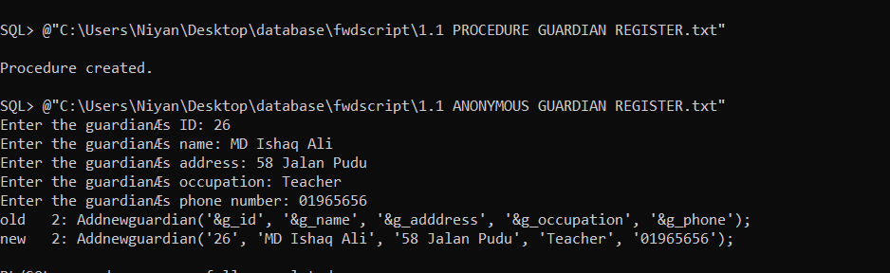
Guardian Register

Slide 16
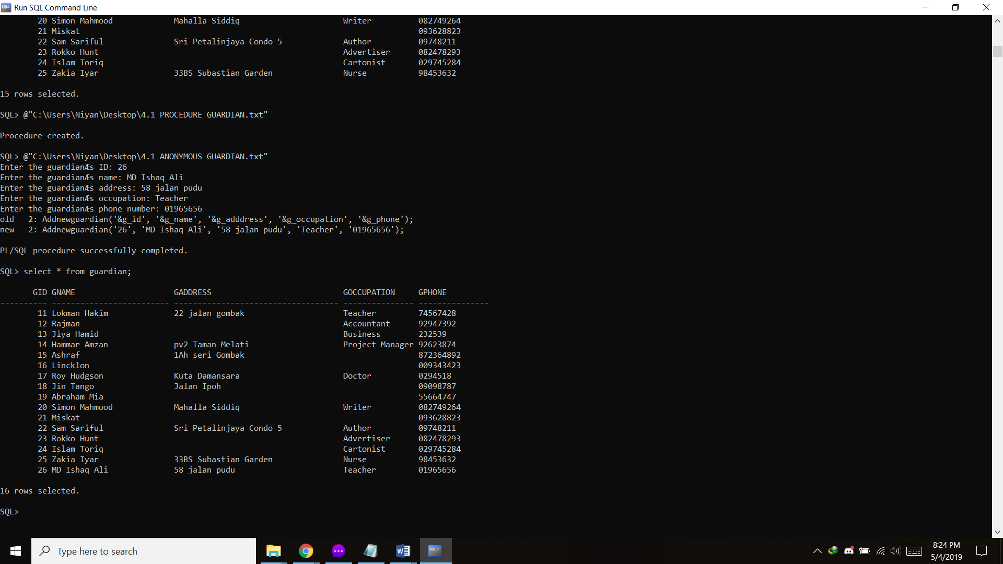
New Guardian Register(Output)

Slide 17
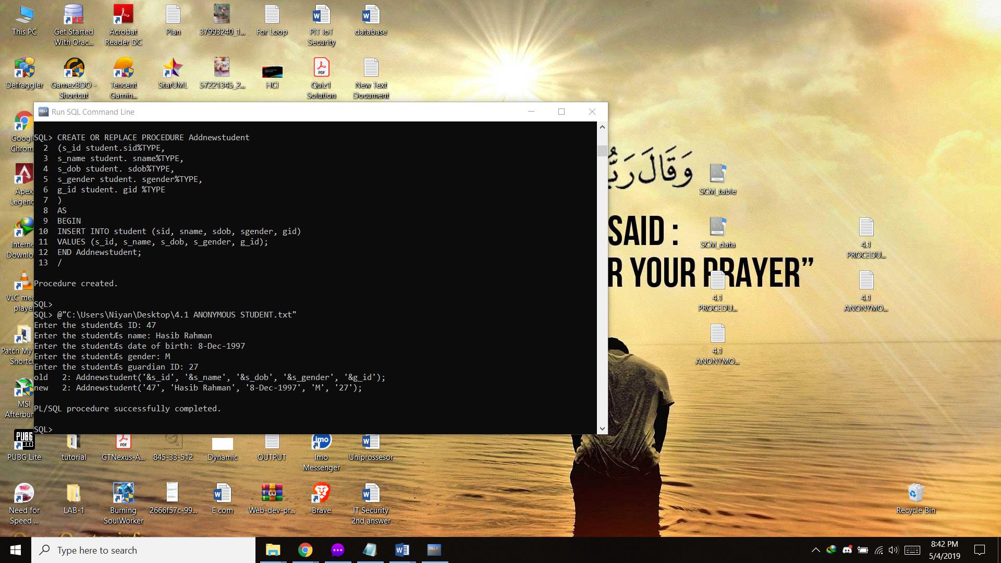
A PROCEDURE TO REGISTER A STUDENT INTO THE DATABASE
CREATE OR REPLACE PROCEDURE Addnewstudent
(s_id student.sid%TYPE,
s_name student. sname%TYPE,
s_dob student. sdob%TYPE,
s_gender student. sgender%TYPE,
g_id student. gid %TYPE
)
AS
BEGIN
INSERT INTO student (sid, sname, sdob, sgender, gid)
VALUES (s_id, s_name, s_dob, s_gender, g_id);
END Addnewstudent;
/

Slide 18
ANONYMOUS BLOCK TO REGISTER STUDENT
ACCEPT s_id PROMPT 'Enter the student ID: '
ACCEPT s_name PROMPT 'Enter the student name: '
ACCEPT s_dob PROMPT 'Enter the student date of birth: '
ACCEPT s_gender PROMPT 'Enter the student gender: '
ACCEPT g_id PROMPT 'Enter the student guardian ID: '
BEGIN
Addnewstudent('&s_id', '&s_name', '&s_dob', '&s_gender', '&g_id');
DBMS_OUTPUT.put_line('The student is successfully registered.');
END;
/

Slide 19
Student Register

Slide 20

New Student Register

Slide 21
A procedure that retrieves the detail of the current term record and guardian details of a student. Call the function from anonymous block to allow the user to enter the student id.
CREATE OR REPLACE PROCEDURE record_details
(stud_id term_rec.SID%TYPE,
term_id OUT term_rec.TERMID%TYPE,
st_date OUT term_rec.Start_Date%TYPE,
fin_date OUT term_rec.Finish_Date%TYPE,
class_id OUT term_rec.CID%TYPE,
teacher_id OUT term_rec.TID%TYPE,
guardian_id OUT guardian.GID%TYPE,
guardian_name OUT guardian.GName%TYPE,
guardian_address OUT guardian.GAddress%TYPE,
guardian_occupation OUT guardian.GOccupation%TYPE,
guardian_phone OUT guardian.GPhone%TYPE)
AS
BEGIN
SELECT TERMID, Start_Date, Finish_Date, CID, TID
INTO term_id, st_date, fin_date, class_id, teacher_id FROM term_rec JOIN student USING (sid) WHERE sid = stud_id; SELECT GID, GName, GAddress, GOccupation, GPhone
INTO guardian_id, guardian_name, guardian_address, guardian_occupation, guardian_phone
FROM guardian JOIN student
USING (gid) WHERE sid = stud_id;
END;

Slide 22
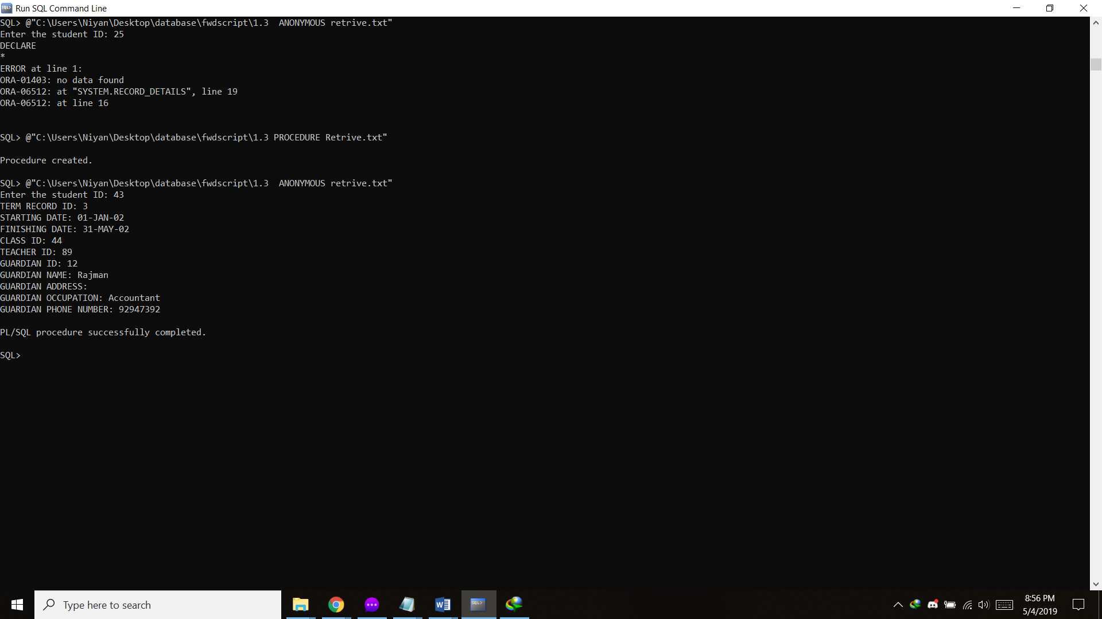
Retrive the details

Slide 23
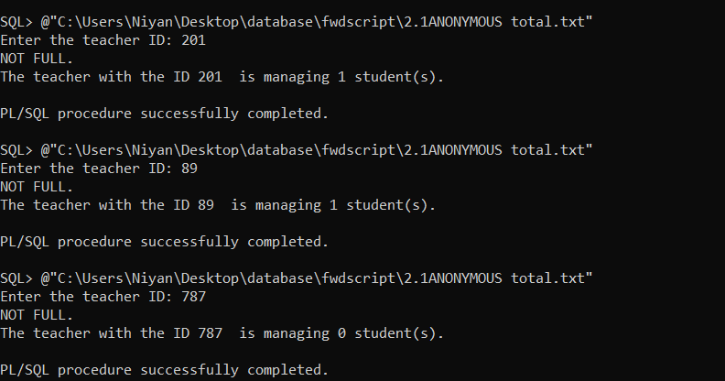
A function that calculates the total number of students managed by each teacher. If the teacher has managed more than 3 (three) student, display the status as ‘FULL: TEACHER STUDENT RATIO IS MAXIMUM’.

Slide 24

A FUNCTION THAT DETERMINES THE REGISTRATION FEE
If 1 student =450
More than 2=400 per

Slide 25
Thank You!!

